Slide 1

DEPARTMENT OF COMPUTER SCIENCE ENGINEERING (ARTIFICIAL INTELLIGENCE AND MACHINE LEARNING)
AMB1331 – DESIGN PROJECT
BATCH - 9
Presented by :
SAMEEHA J
SUDHARSON S R
VETHAABINAYA S
VIMAL AANANTH B R
Guided by :
Mr. C. MUTHUKUMARAN M.E., (Ph.D.)
AP – CSE(AIML)

Slide 2
Real-Time Medicine Availability Tracker for Emergency Healthcare

Slide 3
PROBLEM STATEMENT
People struggle to find specific medicines in nearby pharmacies. No centralized system exists to check real-time medicine availability. Users often waste time visiting multiple shops. Lack of digital connectivity between pharmacies and customers. Difficulty in locating nearby pharmacies quickly.

Slide 4
RESEARCH OBJECTIVE
The primary objective of this project is to develop a smart and efficient system that helps users find the availability of medicines in real time from nearby pharmacies. The system aims to reduce the time and effort required to search for essential medicines, especially during emergency situations.
📌 Scope of the Project
Real-time medicine availability tracking Location-based pharmacy search using GPS Quick and efficient medicine search with autocomplete Admin management for pharmacy and stock updates Online purchasing and cart system integration
Suitable for emergency healthcare support

Slide 5
EXISTING SYSTEM
Currently, people depend on traditional methods such as visiting multiple pharmacies or making phone calls to check medicine availability. There is no centralized system that provides real-time information about nearby pharmacies and their stock.
📌 Limitations
No real-time medicine availability information Time-consuming manual search process No location-based pharmacy detection Lack of accuracy and reliability No integration with online purchasing systems Difficult during emergency situations

Slide 6
PROPOSED SYSTEM
The proposed system is a Real-Time Medicine Availability Tracker that allows users to search for medicines and find nearby pharmacies instantly. It uses GPS to detect the user’s current location and displays nearby pharmacies along with available medicines. The system also includes an admin panel to manage pharmacy details, update medicine stock, and handle user orders. Users can add medicines to a cart and purchase them using different payment methods.
📌 Merits:
Real-time medicine availability Faster and more accurate search & payment options GPS-based nearest pharmacy detection & Online purchase Efficient admin management system & Reduces time during emergencies

Slide 7
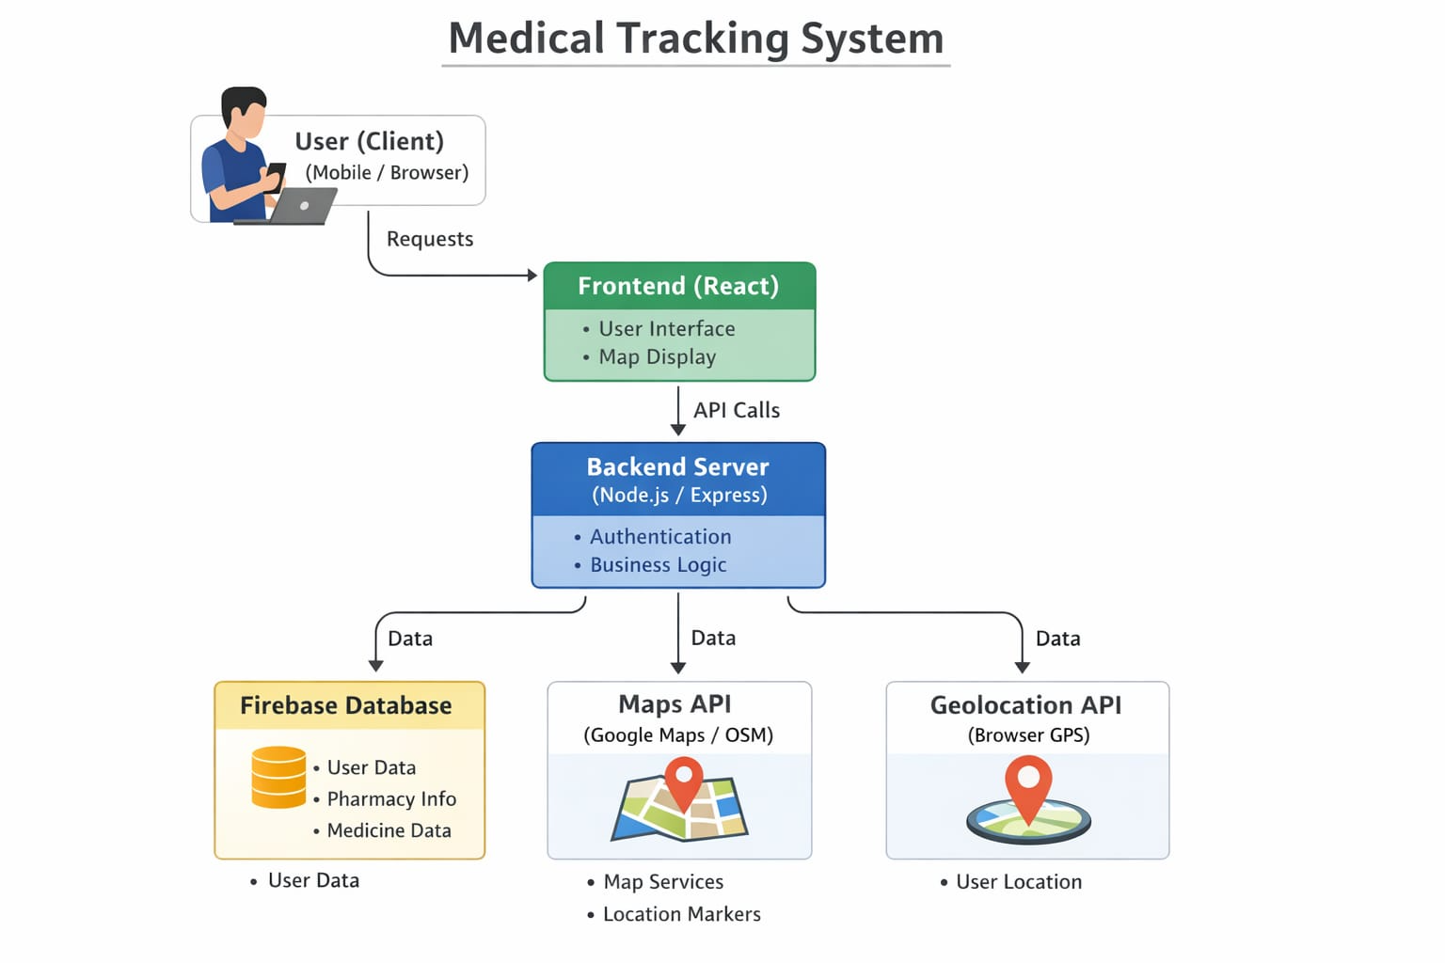
SYSTEM ARCHITECTURE

Slide 8
WORKING PRINCIPLE
The system works by integrating location services, database management, and user interaction modules:
The user enters a medicine name in the search bar The system provides autocomplete suggestions User location is detected using GPS Nearby pharmacies are identified based on location Medicine availability is fetched from the database Results are displayed along with distance and details Users can add medicines to cart and proceed to purchase Admin updates ensure real-time stock accuracy

Slide 9
IMPLEMENTATION DETAILS
PROJECT IMPLEMENTATION
The project is implemented using modern web technologies and database integration:
Frontend developed using React / Vite for responsive UI Backend/database used for storing pharmacy and medicine data GPS integration for real-time location detection Map integration for displaying pharmacy locations Admin panel for managing stock and pharmacies Cart and payment system implemented for user transactions

Slide 10
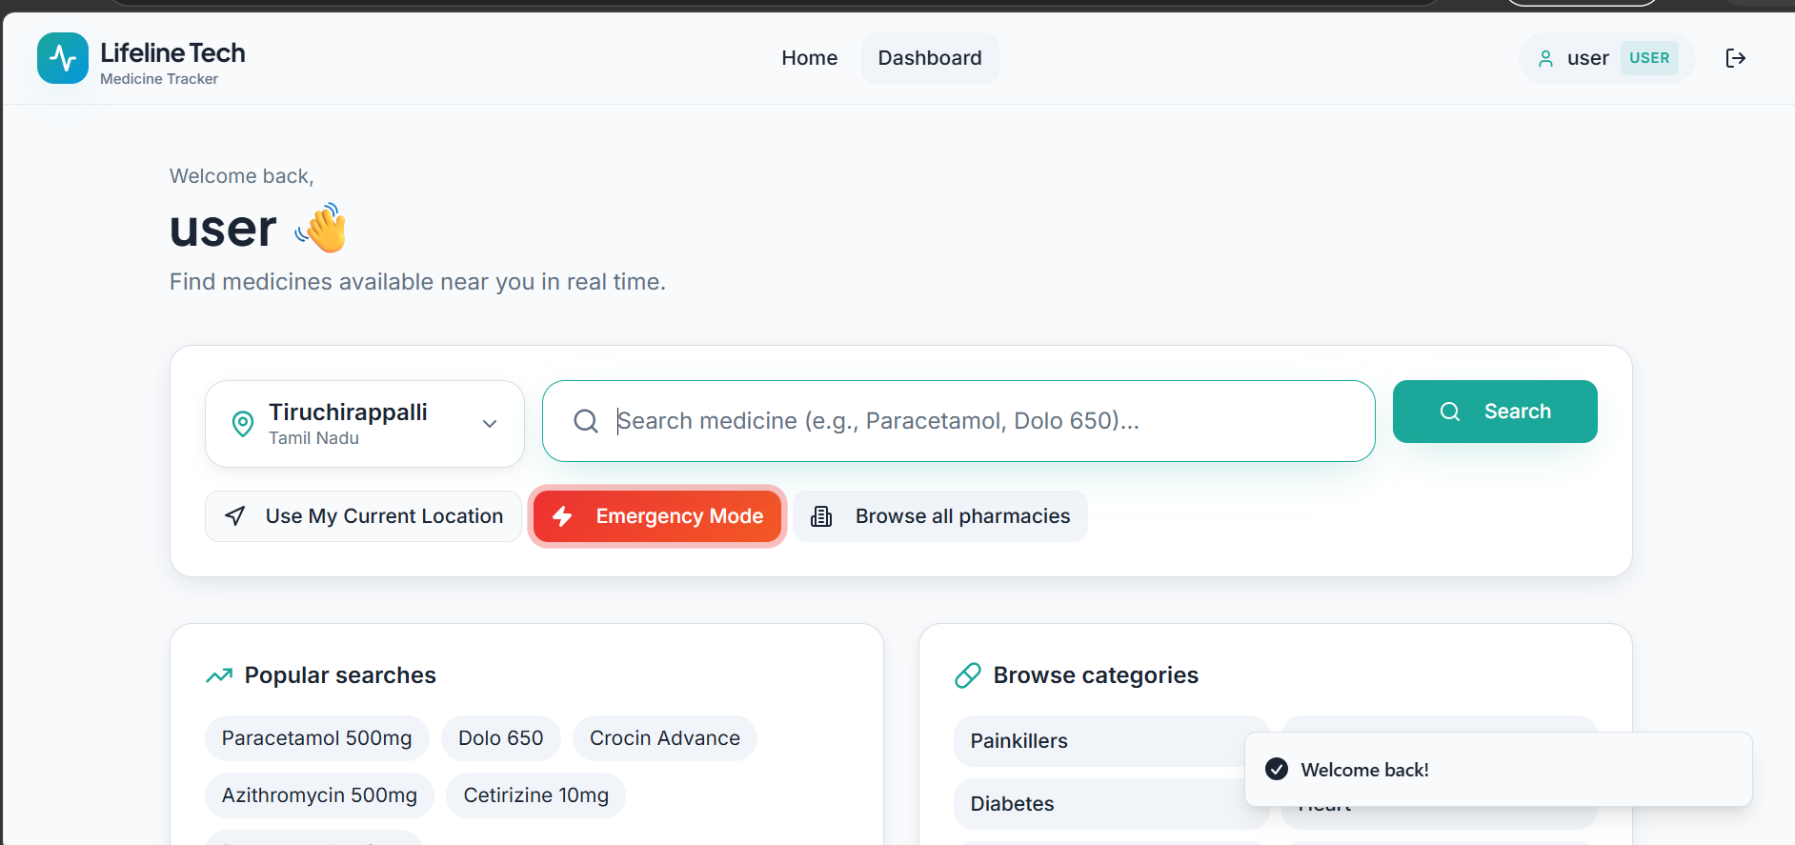
OUTPUT/ RESULT

Slide 11
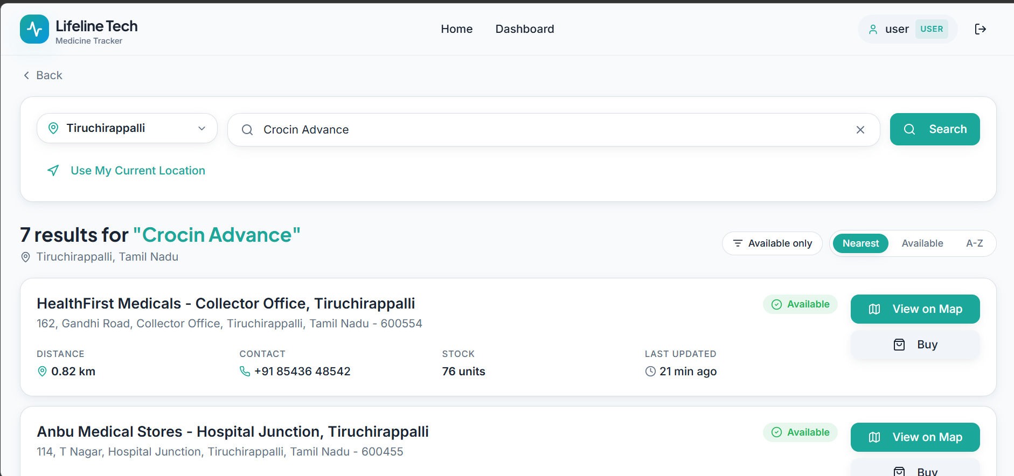
OUTPUT/ RESULT

Slide 12
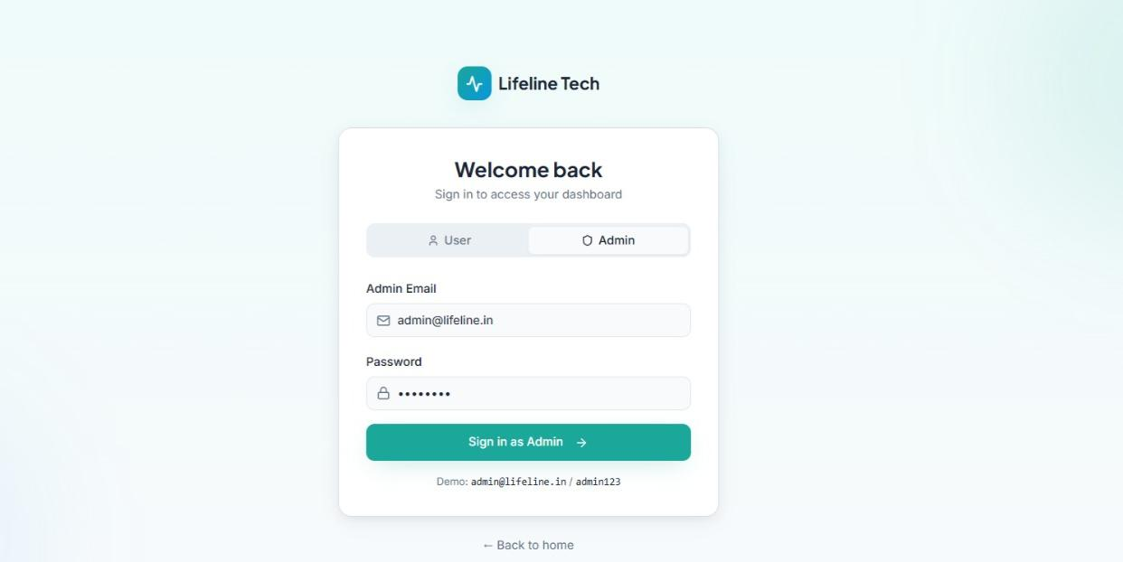
OUTPUT/ RESULT

Slide 13
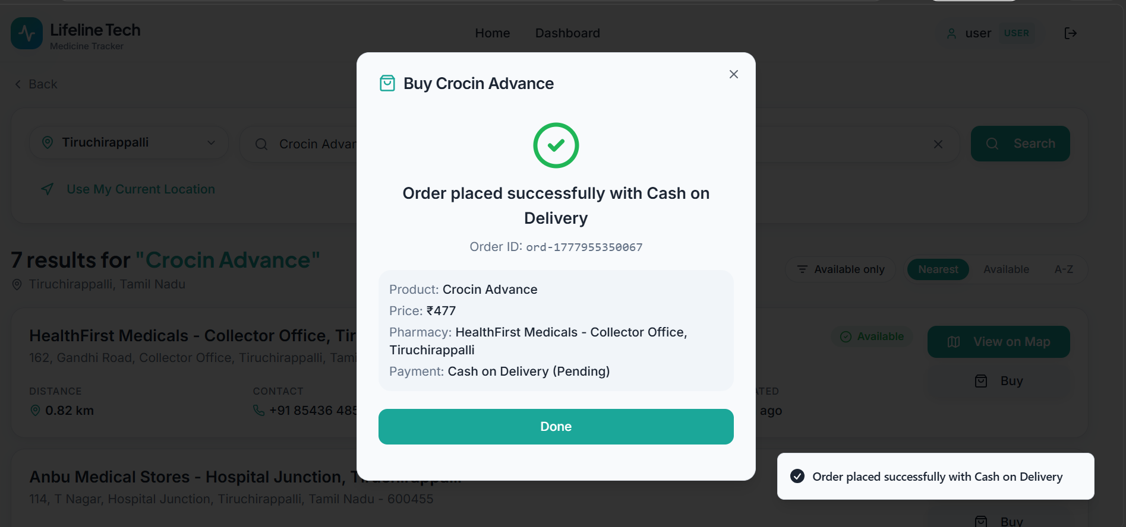
OUTPUT/ RESULT

Slide 14
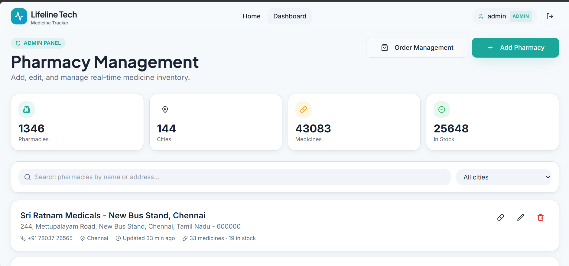
OUTPUT/ RESULT

Slide 15
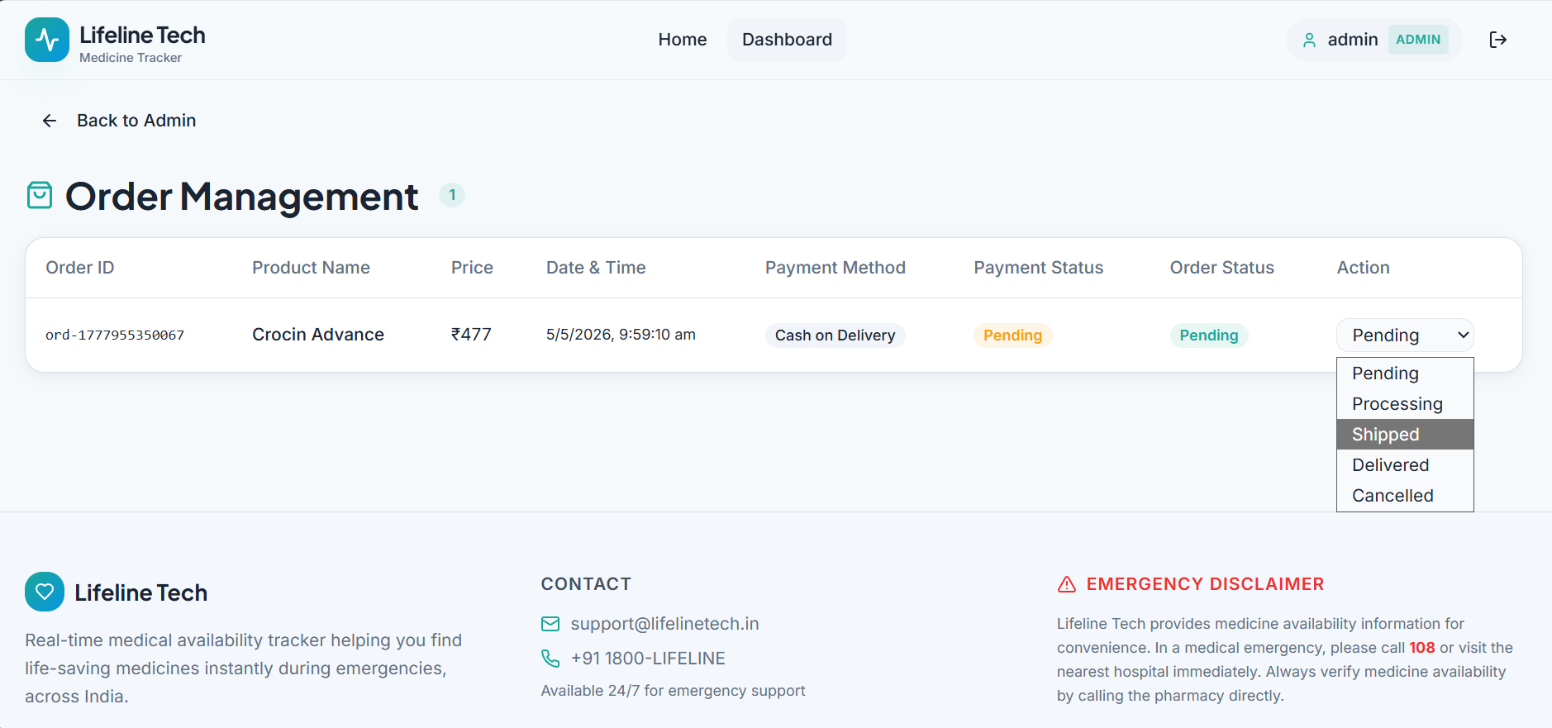
OUTPUT/ RESULT

Slide 16
CONCLUSION & FUTURE ENHANCEMENTS
The project successfully provides a smart solution for locating medicines in real time. It reduces the effort and time required to find essential medicines and improves accessibility during emergencies. The system is efficient, user-friendly, and reliable for modern healthcare needs.
🚀 Future Enhancements
Integration with real pharmacy APIs for live stock updates Mobile application development AI-based medicine recommendation system Online doctor consultation integration Advanced analytics for demand prediction Multi-city and nationwide expansion

Slide 17
Thank You

